Slide 1
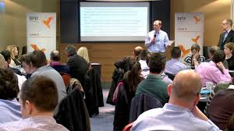
Organizational Development Event
Business Development Seminar

Slide 2
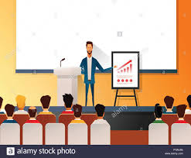
Introduction
Was sponsored by Zuan Technologies on January 25th, 2020
Was held in India at Zuan headquarters located in Kodambakkam
It was a gateway for mastering and building a world-class sales team
Expounded on best ways to close sales for business development
Notes:
“Business Development Seminar” was held at Kodambakkam, which is headquarters for Zuan Technologies. It was held on January 25th, 2020, and was sponsored by Zuan Technologies Limited (Haider, et al. 2017). The Zuan business development plan seminar is among the proven foundation for building and mastering a top-notch yet international sales team. The primary goal of seminar organizers was to expound more on the best ways for closing sales to attain business development (Zuan, 2020).

Slide 3
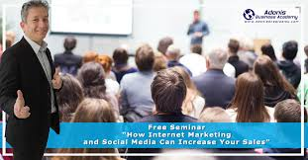
Key topics discussed
Introduction to the sales process
Sales ethics
Sales techniques
Sales prospecting
Notes:
The event was planned to address the sales process, which begins with making an introduction to a customer, followed by introducing a product, stating the deal, and lastly, closing a sale. Sales techniques were also discussed, which includes asking the customers questions and feeding them with appropriate information before closing a sale. The seminar provided the attendees with various methods of winning more customers, which entails using all means possible and constancy (Arnett & Wittmann, 2014)

Slide 4

Key topics discussed
Sales closing techniques
Boosting sales volume
Phone pitching tactics
Tips for closing sales faster
Notes:
Sales closing techniques are yet another topic that was discussed during the seminar. Among the closing techniques, which were considered include assumptive, option, and suggestion closing. Since the company is concerned about selling technology-based products, the attendees were provided with techniques of pitching phones, which would later boost the sales volume of a particular company. Again, the trainers emphasized more on closing sales faster to prevent negative feedback from a potential customer (Eneizan, Abd Wahab & Obaid, 2016).

Slide 5
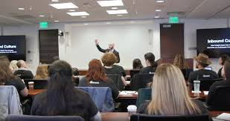
Attendees
Anyone with interest in sales and marketing
Business vs. Business sales professionals
Business development professionals
Sales and marketing executives
Managers with marketing responsibility
Executives with marketing oversight
Notes:
Attendees come came from various business settings. Notably, there was a group of business partners who could share their techniques in marketing and sales strategies. Besides, the participants included anyone interested in sales and marketing, as well as diverse business development professionals (Winston & Mintu-Wimsatt, 2013). Among the audience, there were Managers with marketing responsibility of managing a sales team in addition to executives with marketing oversight.

Slide 6

How the attendees benefited
Learned effectiveness of sales cycle
Perspectives of seeking sales prospects- consistency, all methods available focusing and on outcomes
Learned different selling tactics
Notes:
The participants were educated on the significance of perfecting the sales cycle. The cycle begins with making an introduction to a customer, followed by presenting a product, stating the deal, and lastly, closing a sale. The above steps are critical in making good use of the sales cycle. Perspectives of seeking sales prospects were also discussed, which included consistency, all possible methods available, and focusing on outcomes (Winston & Mintu-Wimsatt, 2013). The commonly known different tactics of selling were covered. Selling tactics introduced were understanding the perspective and need of the customer by showing empathy and identifying core principles (Zuan, 2020).

Slide 7
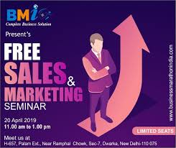
How the attendees benefited
How do tactics work for different customers?
Different techniques for different
customer
Influencing customers to become premium clients
Were taught sales closing techniques
Assumptive closing, option close
and suggestion close
Notes:
During the seminar, training professionals confirmed that some tactics work best for different customers. As a result, they were encouraged to apply different techniques for different customers. A qualified seller should not focus on making a sale to new customers, but also transitioning them to be premium clients. Once a sale person has a premium client, it gives a consistent assurance purchase from that particular client (Winston & Mintu-Wimsatt, 2013). Closing a sale may seem to be a less involving activity; however it demands the seller to apply exceptional tactics since it is the most crucial and last stage. Assumptive, option, and suggestion closing are the most utilized methods for ascertaining the potentiality of a customer (Zuan, 2020).

Slide 8

Essential skills gained by participants
Advanced selling skills
Escalated business development strategies
Improved participation while in a group
Leaned to be roles models
Notes:
Those who attended the seminar gained significantly as opposed to those who did not. They gained hugely by having access and working with business development strategists to realize the better outcome (Winston & Mintu-Wimsatt, 2013). The audience from Business Development Seminar was evidenced to have advanced selling skills as well as improved participation while in a group. Notably, the seminar was led by inspirational sales leaders who tailored their professional skills to win more customers (Zuan, 2020).

Slide 9
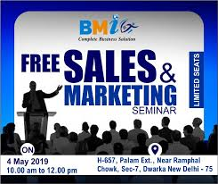
Critical skills gained by participants
Learned how to be enthusiastic yet inspirational sales leaders
Provided with real-world examples
Visual aided demonstration for closing a sale
Advanced objection handling technique
Notes:
The seminar was organized in a way that promoted sharing and participation between all the participants. Teaching methods were somewhat practical, which involved providing the attendees with real-world examples (Arnett & Wittmann, 2014) . In addition to a motivation-based seminar, the participants could have access to a visual aided demonstration for a better closing of a sale. It was, however, worth noting that not all customers will accept to buy the products, and is always vital for sellers to put in place objection handling technique (Zuan, 2020).

Slide 10
References
Arnett, D. B., & Wittmann, C. M. (2014). Improving marketing success: The role of tacit
knowledge exchange between sales and marketing. Journal of Business Research, 67(3), 324-331.
Eneizan, B. M., Abd Wahab, K., & Obaid, T. F. (2016). Effects of green marketing strategies on sales
volume of green cars. Singaporean Journal of Business, Economics and Management Studies, 51(3814), 1-14.
Haider, A. A., Zafar, A., Khalid, A., Majid, A., Abdullah, M. A., & Sarwar, M. B. (2017).
Marketing Management. Head, B, 22.
Winston, W., & Mintu-Wimsatt, A. T. (2013). Environmental marketing: strategies, practice,
theory, and research. Routledge.
Zuan (2020). Business Development Seminar. Close a sale like a pro. Retrieved from
https://www.zuantechnologies.com/seminar/sales-and-marketing

